Slide 1
Module 2
Creating Sophisticated Document Structures using HTML

Slide 2
Content
How to Capture User Input
Introduction to HTML5 Semantic Elements
How to work with Scalable Vector Graphics (SVG)
How to Implement Media Controls
How to add additional HTML features to a web page
How to use advanced features of HTML such as forms

Slide 3
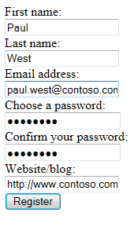
Gathering User Input by Using Forms in HTML
The <form> element provides a mechanism for obtaining user input
The action attribute specifies where the data will be sent
The method attribute specifies how the data will be sent
Many different input types are available
Notes:
Keep this topic short. It is tempting to go into all the nuances of the different types of input available, but save this discussion for module 4, which covers forms and validation in more detail.
20480C
1: Overview of HTML and CSS

Slide 4
Declaring a Form in HTML5
<div><label>Your name</label>
<input type="text" name="myName" >
</div>
<div>
<label>Your email</label>
<input type="email" name="myRole">
</div>
<input type="submit" value="Submit now">
<div>
Date: <input type="date" name="myDate" id="">
</div>
<div>
Bonus:<input type="number" name="myBonus" >
</div>
<div>
Are u eligible?: <input type="checkbox" name="myEligibility">
</div>
Notes:
Emphasize the difference in purpose between the name and id attributes for input controls. Highlight the best practices for specifying the various elements in a form that enable them to be styled and processed more easily.
20480C
4: Creating Forms to Collect and Validate User Input

Slide 5
Semantic Elements
Below is a subset of new functionality available in HTML5:
Introduced many semantic elements
Structure
<section>
<header>
<footer>
<article>
Inline
<mark>
<time>
Standardized multimedia (audio/video) playback elements

Slide 6
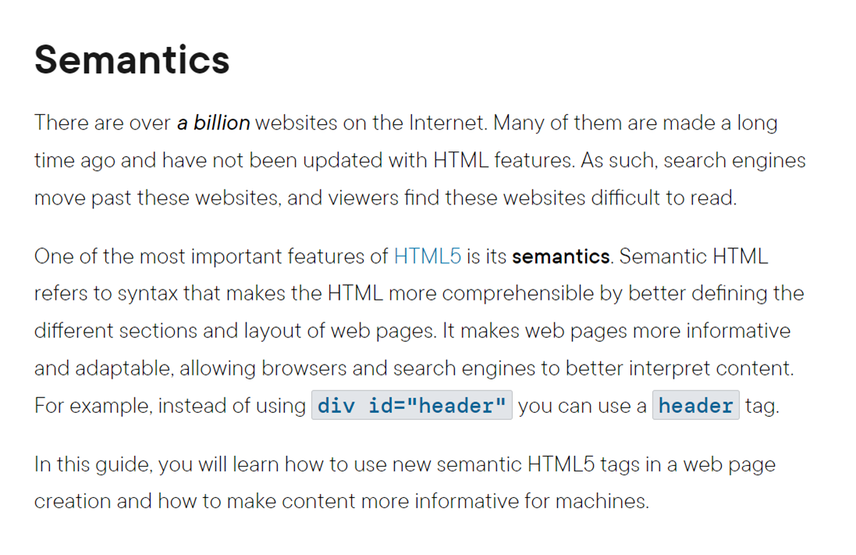

Slide 7
semantic
Helpful for seo too(search engine optimizations)
Developers will also know that it is a header and it is a footer …if we

Slide 8
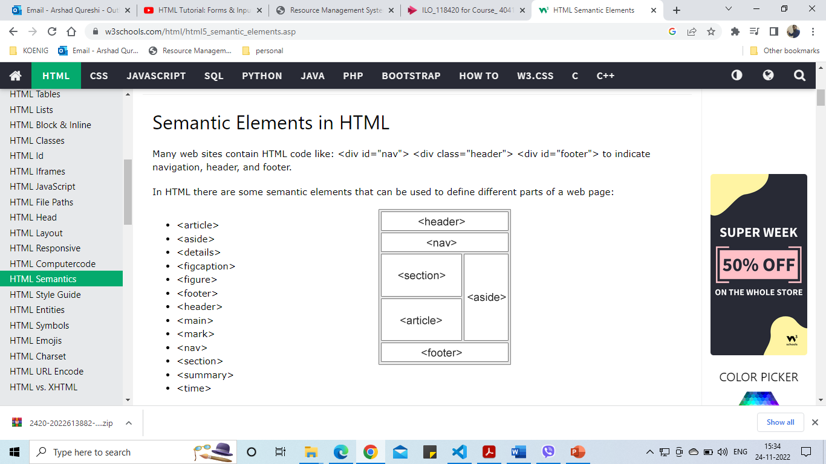
Semantic tags

Slide 9
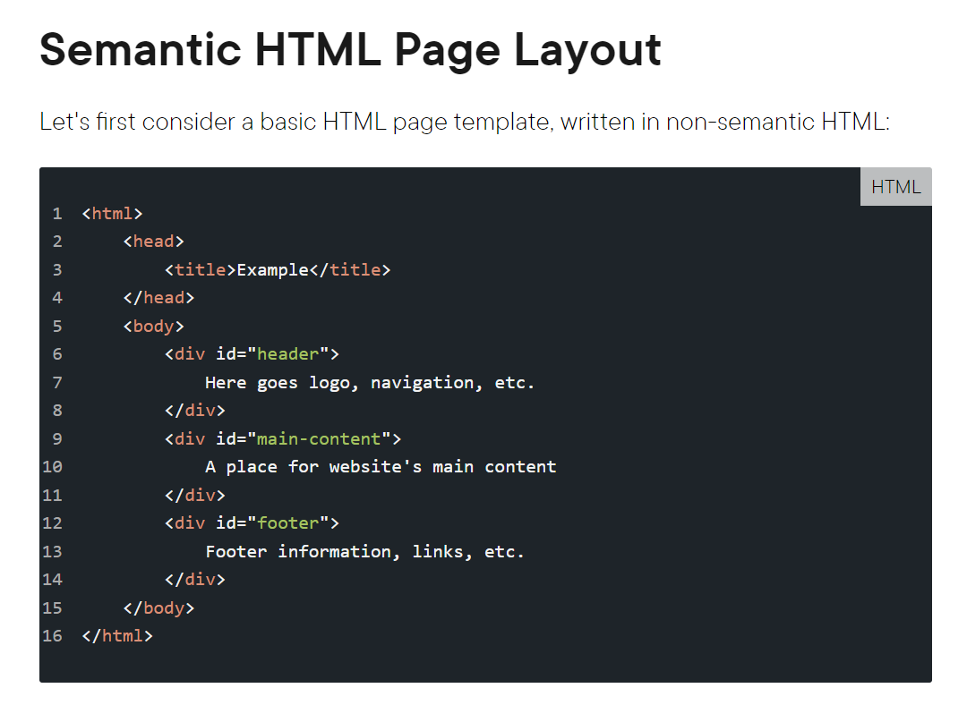

Slide 10
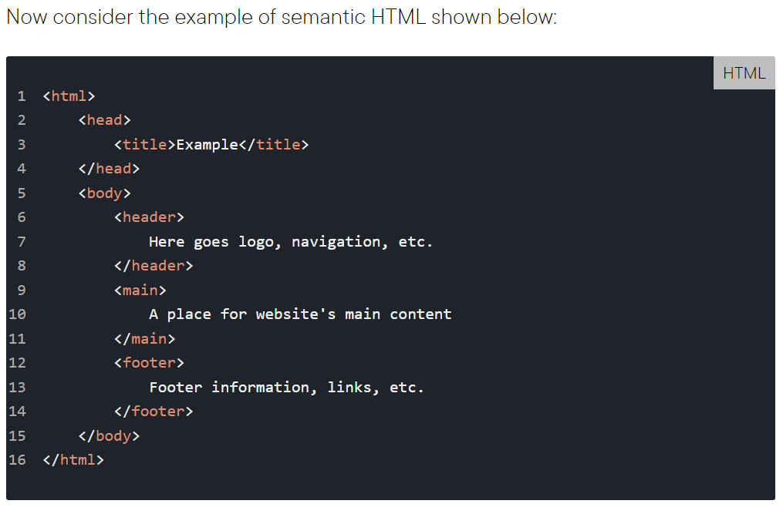
The main difference: we have replaced div tags with 3 new tags: header, main, header, main, and footer tags are semantic because they are used to represent different sections on an HTML page. These are more descriptive than div tags which make partitioning webpages into tangible sections difficult.

Slide 11
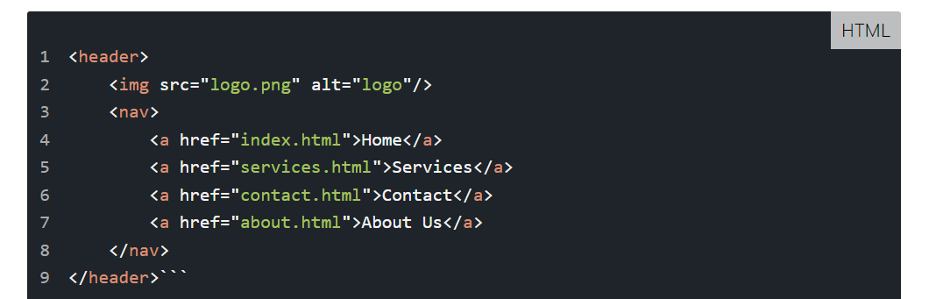
Navigation
In HTML5, there is the nav tag, which replaces the former jack-of-all-trades, div, to wrap links that make a navigation menu. For instance, the navigation menu can be inserted within the header section:
Generally, the navigation menu can be put anywhere on a page, it just needs to be wrapped with the . However, it shouldn't be put inside main, unless the navigation is specific for that page. This restriction exists because main elements should only be specific for the page, while header and footer are generally shareable among similar pages.

Slide 12
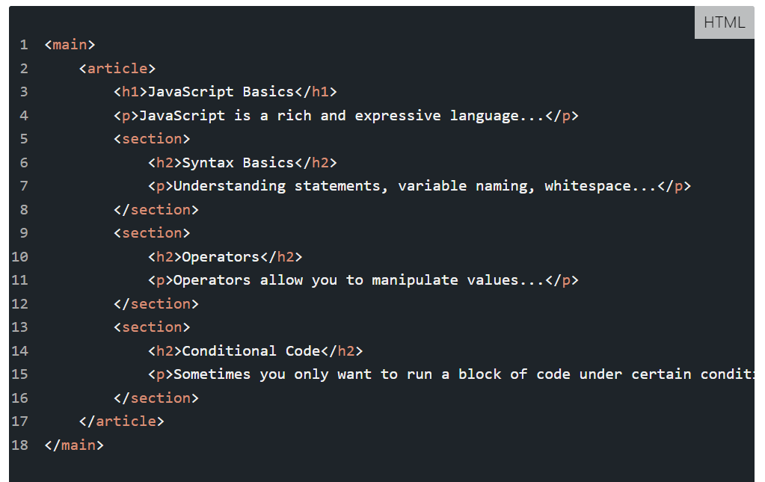
Main Content
To add some content into the main section, we can use new HTML5 tags, such as article and section. These tags simplify the structure of main, making it look like:

Slide 13
Main Content, Article and Section
The article tag is used for wrapping an autonomous content on a page. A content is autonomous if it can be removed from the page and put on some another page. The article tag can contain several section tags inside it, like in our example. An article is actually an autonomous section.
The section tag is similar to the div tag, but it is more meaningful since it wraps logical groups of related content (e.g. a chapter of an article). The section tag can be also used to wrap the article itself, but we have the article tag for that purpose.
Aside section
An additional content, unimportant for understanding an article, but related to the article, can be inserted into the aside section. For instance, it could be information about how many people read the article, who is the author of the article, and so on.

Slide 14
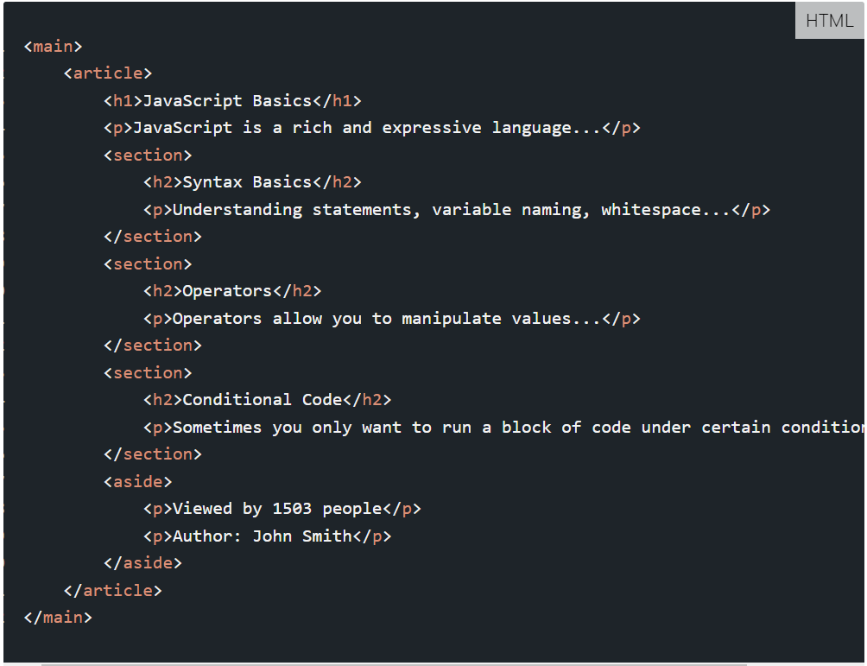

Slide 15
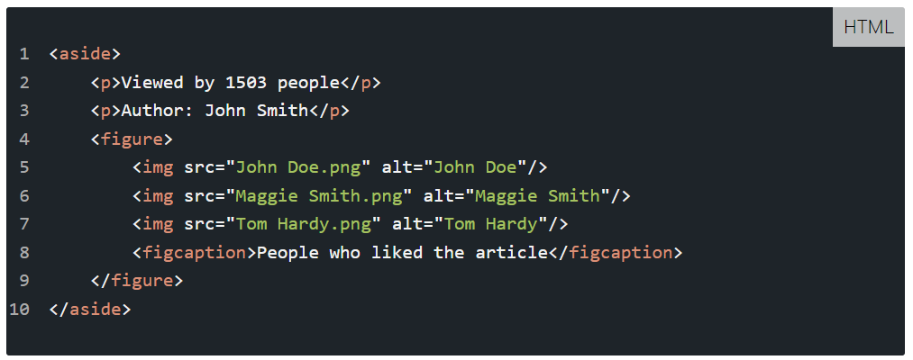
Figures
The figure tag is used to mark up photos, code blocks, diagrams, charts, illustrations, and other graphic content. The figcaption tag represents a caption or legend for a figure. It's optional and can be omitted. Only one figcaption tag can be nested into the figure tag. Even if a figure contains multiple images, there can be only one figcaption for all of them.

Slide 16
Overview
SVG stands for Scalable Vector Graphics
In terms of graphics, scalable means not being limited to
single, fixed units.
In terms of Web, scalable means that a particular technology
can grow to a large number of files, a large number of users,
a wide variety of applications.
SVG, being a graphics technology for the Web, is scalable in
both senses of the word

Slide 17
Working with SVG in HTML5
<svg width=”300px" height=”200px"> <g><!-- your graphic here --></g>
</svg>
Working with SVG Shapes
Transforming SVG
Reusing SVG Elements
Drawing Paths
Using Patterns and Gradients with SVG

Slide 18
Rectangle and Circle in SVG
<svg width="100" height="100">
<rect x="10" y="10" rx="5" width="80" height="80" fill="yellow" stroke="red" stroke-width="5"/>
</svg>
<svg width="200" height="200">
<circle cx="80" cy="80" r="40" stroke="green" stroke-width="4"/>
</svg>

Slide 19
back ground image as svg
<style>
.container{
height: 1000px;
width: 1000px;
background: #eee url("horse.svg") no-repeat;
border: 1px solid grey;
font-weight:400;
font-size: 49px;
color: rgb(204, 72, 154);
}
</style>
<div class="container">
<!-- <img src="horse.svg" alt="svg image loading" height="100px" width="100px"> -->
gsjadjddjhfhaj
</div>

Slide 20
Media Elements
The media elements allow you to specify video/audio source[s], along with some parameters to play video or audio directly on your HTML page.
You can specify multiple sources for your multimedia so that each browser can play the files that it natively supports
You can also style the media player using CSS to fit your design needs. You can even control which aspects of the media player are available using attributes such as controls

Slide 21
Media elements video
<body>
<video width="300px" controls>
<source src="video_audio.mp4" type="video/mp4">
</video>
</body>

Slide 22
Audio Elements
<audio controls audio="muted" loop="loop">
<source src="audio.mp3" type="audio/mp3">
</audio>
OR
<audio audio="muted" loop="loop">
<source src="popopen.wav" type="audio/wav" />
<source src="popopen.ogg" type="audio/ogg" />
<source src="popopen.mp3" type="audio/mpeg" />
</audio>

